Slide 1

Career Guidance System
ABES Engineering College, Ghaziabad, UP
Department of CSE-AIML
Project Presentation-1
Project Domain: Machine Learning
Project Group No: CSE-AIML24-B24
Project guide: Mr. Utkarsh
Team members:
PRAKHAR TANDON(20003215300087)
AYUSH KUMAR TIWARI(2100321538001)
PRATHAM SINGHAL(2000321530091)

Slide 2
Contents
Introduction
Requirements of Project
Existing Work related to Project
Analysis of Problem Based on Project Objective

Slide 3
Introduction
A career guidance system is a valuable tool designed to assist individuals in making informed and strategic decisions about their professional paths. In today's complex and ever-evolving job market, where numerous career options and specializations are available, having a reliable career guidance system is crucial. This system serves as a compass to help individuals navigate the vast sea of possibilities, taking into account their interests, skills, values, and goals. Whether you're a student exploring potential career choices, a professional seeking a career change, or someone looking to enhance your current career, a well-designed career guidance system can provide invaluable insights and resources to support you in achieving your career aspirations. In this rapidly changing world, where new industries emerge and traditional roles evolve, a career guidance system can be your trusted partner in charting a course to a fulfilling and successful professional future.

Slide 4
Requirements of Projects
Scope:
Self-Assessment: Assist users in identifying their strengths, weaknesses, interests, values, and skills to align their personal attributes with suitable careCareer Exploration: Enable users to explore a wide range of career options, industries, and job roles to gain a comprehensive understanding of what's available.
er paths.
Goal Setting: Help users define and set clear career goals, whether they are short-term or long-term, and create actionable plans to achieve them.
Education and Training Recommendations: Offer suggestions for the necessary education, training, certifications, or qualifications required for specific career paths.
Resume Building: Provide tools and templates for creating effective resumes and cover letters tailored to specific industries and positions.
Job Search Assistance: Facilitate job searches by connecting users to relevant job postings, internship opportunities, and networking events.

Slide 5
Requirements of Projects
Technical Requirements:
Front-End:
HTML and CSS for user interfaces.
Bootstrap for styling.
Flask to connect python with Frontend.
Machine Learning:
Support Vector Machine(SVM)
XG Boost
Decision Tree
Sklearn
Numpy, Pandas, Pickle and Joblib
Accuracy has been improved in the adaptive boosting algorithm to an accuracy rate of 94%

Slide 6
Existing Works related to Project
Online Career Platforms:
LinkedIn: LinkedIn offers career guidance features, such as job recommendations, professional networking, and skill development, to help individuals explore and advance in their careers.
Indeed: Indeed provides job search, resume building, and company reviews to assist users in making career-related decisions.
Glassdoor: In addition to job listings, Glassdoor offers company ratings, reviews, and salary information to help job seekers make informed choices.
. AI and Data-Driven Systems:
CareerBuilder: CareerBuilder uses AI and machine learning to match job seekers with relevant job postings based on their skills and preferences.
Monster.com: Monster.com offers a chatbot called "Job Seeker" to provide personalized career advice and help users find suitable job opportunities.

Slide 7
Analysis of Problem Based on Project Objective
To effectively design and develop a career guidance system, it's crucial to conduct a thorough analysis of the problems and challenges that individuals face when it comes to career-related decisions. Here's an analysis of the common issues and challenges that a career guidance system aims to address:
Information Overload: In today's digital age, there is an abundance of information about various careers, industries, and educational paths. Individuals often struggle to filter and access relevant, reliable, and up-to-date information.
Lack of Self-Awareness: Many people have limited self-awareness about their strengths, weaknesses, interests, values, and personality traits. This lack of self-awareness can hinder effective career decision-making.
Changing Job Market: The job market is continually evolving due to technological advancements, economic shifts, and global changes. Staying informed about these changes and their impact on career choices is challenging.
Education and Training Requirements: Determining the right educational path, including the choice of major, courses, and certifications, can be overwhelming, especially for students.
Limited Networking Opportunities: Networking is essential for career growth, but not everyone has access to networking events, mentors, or career counselors.
.

Slide 8
Analysis of Problem Based on Project Objective
Job Search Challenges: Job seekers often struggle to find suitable job opportunities, create appealing resumes, and navigate the application and interview processes effectively.
Inadequate Career Guidance: Many individuals lack access to professional career guidance services, either due to financial constraints or a shortage of qualified career counselors.
Mismatch Between Skills and Job Requirements: Job applicants may not fully understand the skills and qualifications required for specific roles, leading to mismatches and job dissatisfaction.
Long-Term Career Planning: Individuals may not have a clear understanding of their long-term career goals or may lack a strategic plan for achieving them.
Lack of Support for Career Changes: People considering a career change may face unique challenges, such as identifying transferable skills and finding relevant opportunities.
Inequality and Diversity: There can be disparities in career opportunities and support, particularly for underrepresented groups, which can lead to unequal access to information and opportunities.

Slide 9
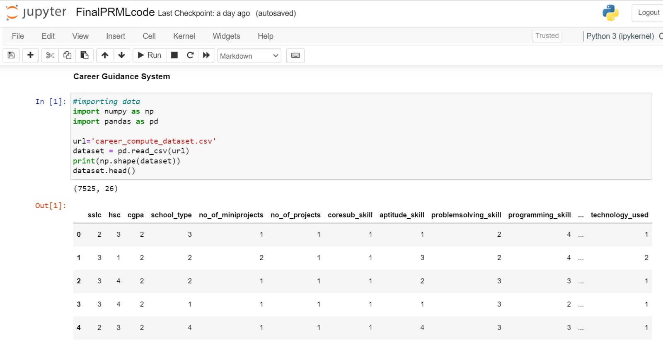
Implementation

Slide 10
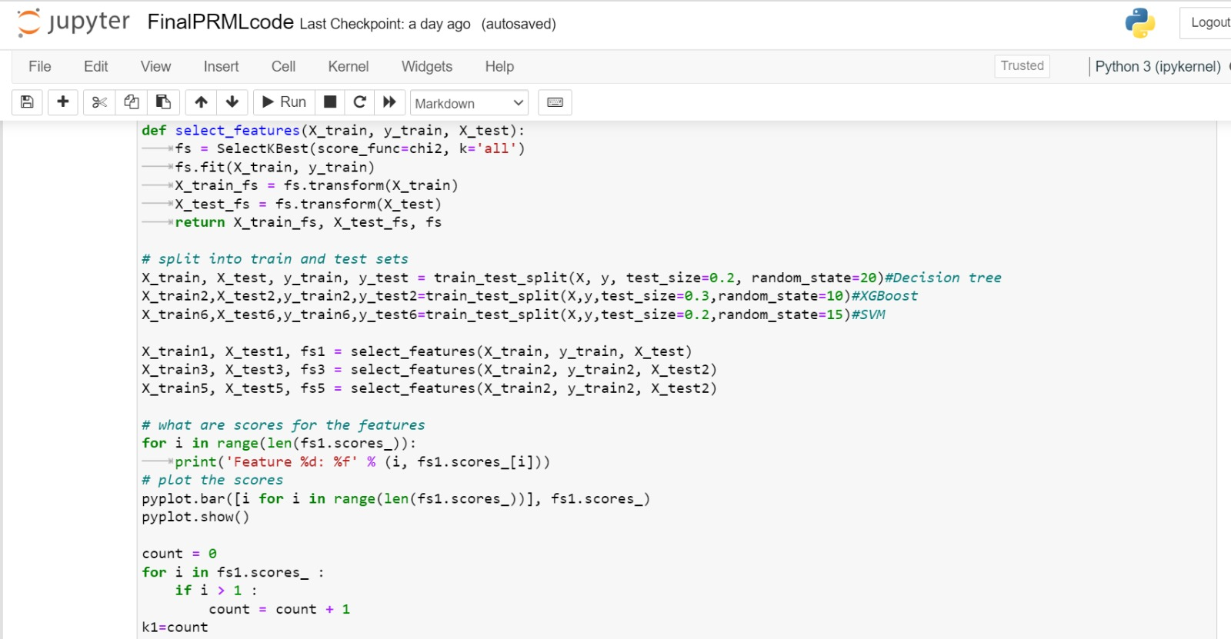
Implementation

Slide 11
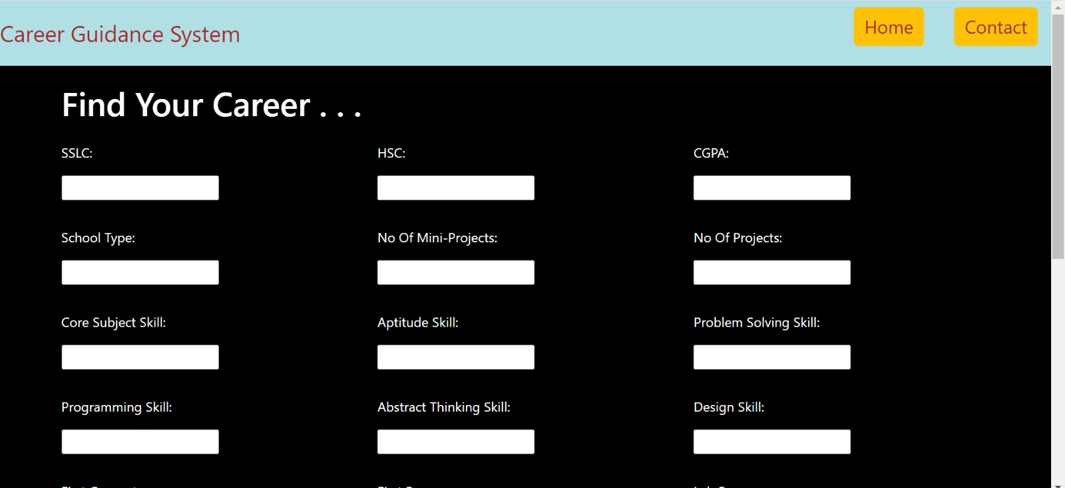
Final Project

Slide 12
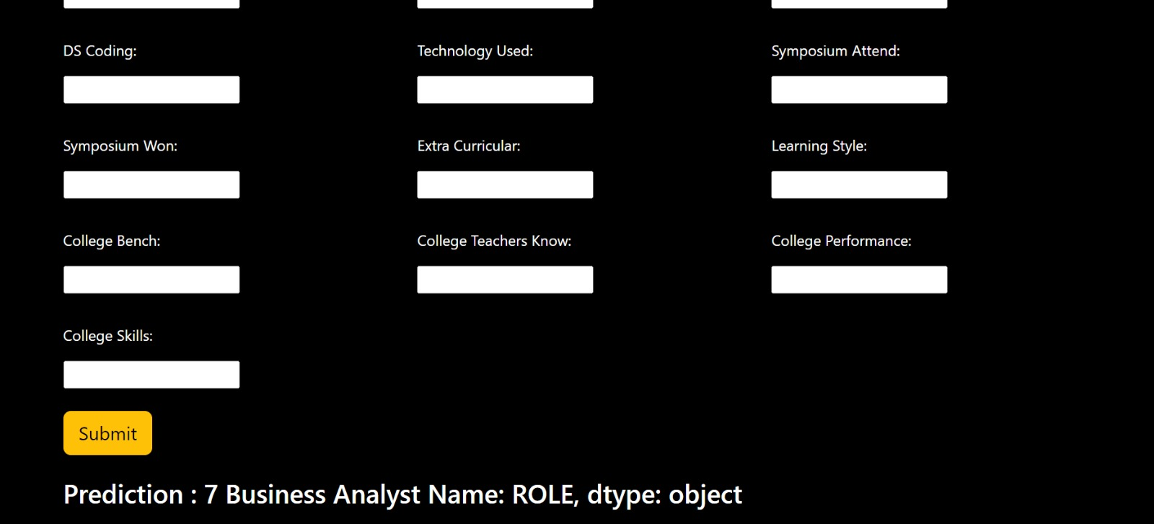
Final Project

Slide 13
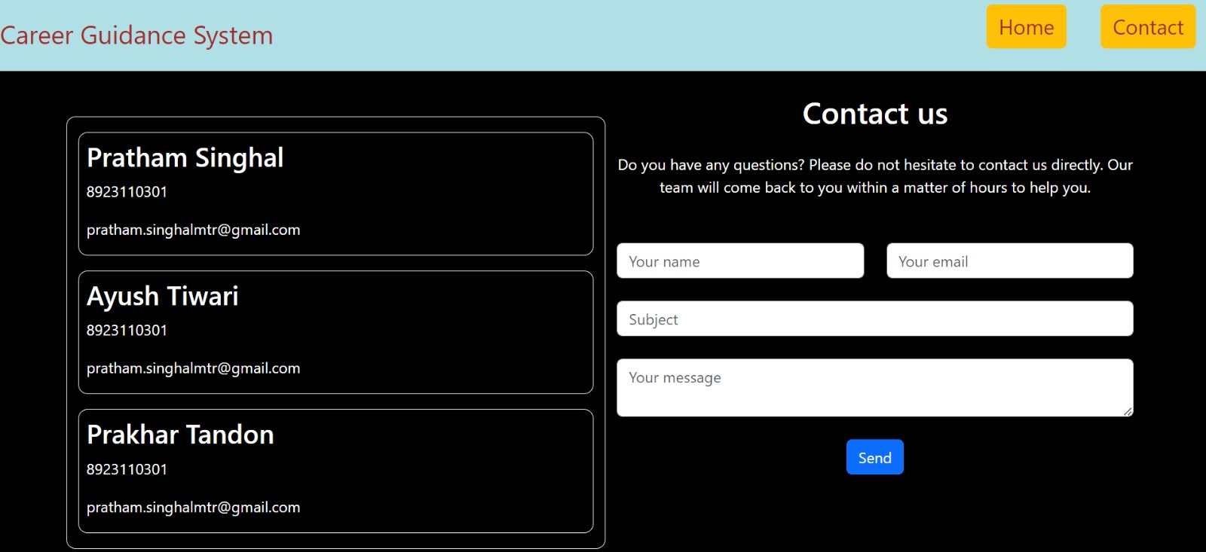
Final Project

Slide 14
Thank You !

